Slide 1
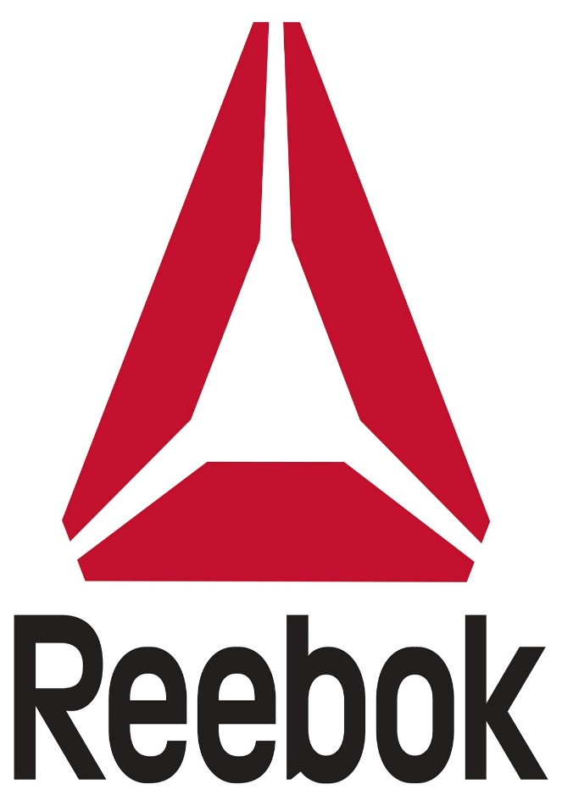

Team 9 – Marketing Management
By – Aditya Thakur Kshitij Sagar Nidhi Maru Venkata Naga Satya Sangeeta Eluri Veerabhadra Satya Deepak Ayyagari

Slide 2
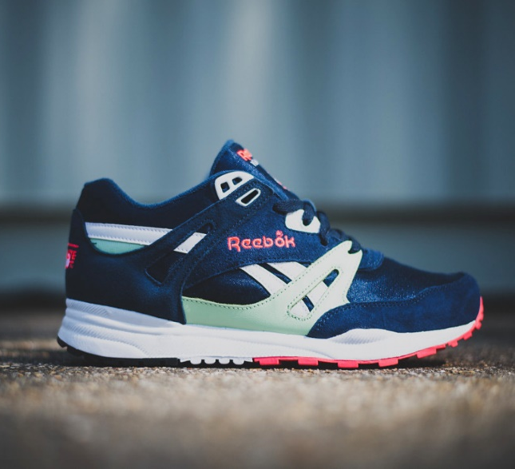
Introduction
Reebok is a global athletic footwear and apparel company, operating as a subsidiary of Adidas, since 2005.
Reebok produces and distributes fitness, running and Crossfit sportswear including clothing and footwear.
Mission: Challenge and lead the fitness world through creativity.
Vision : Fulfilling Potential
Slogan: I am What I am

Slide 3

Objective
Our objective is to provide market scenario od sports shoe industry.
We aim at improving Reebok’s spread and penetration as compared to its rivals – Nike, Puma, Under Armour etc., by providing shoes and merchandizes at affordable prices.
We use strategy of “New Product Development “ to have a new line added to Reebok. – Market Penetration
On the basis of research done, we suggest a few recommendations as future aspects.

Slide 4
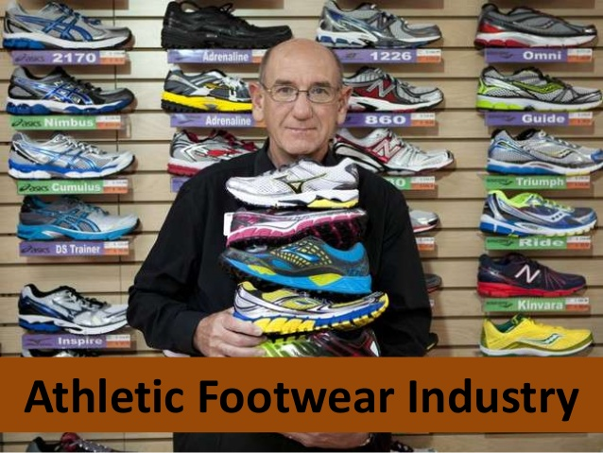

Challenges and Needs faced
Challenges
Emerging trends in sports and fitness
Changing customer lifestyle
Need
Increasing use of eco-friendly products
Innovations in sole technology
Growing preference for premium and customized products
Emerging role of e-commerce

Slide 5
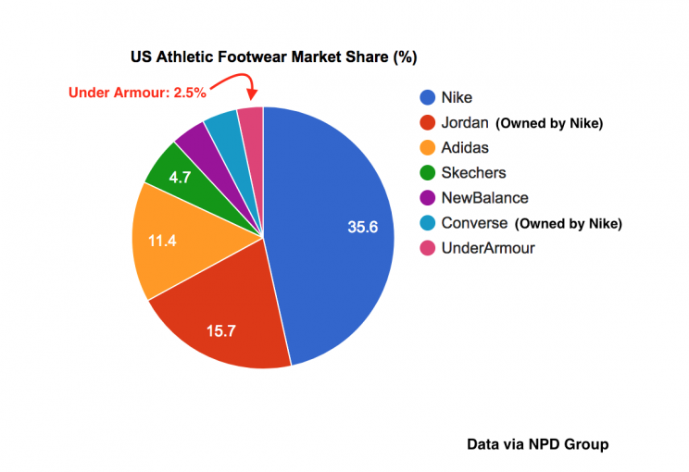
Competition in Sports shoe industry
Major Players
Nike
Reebok (Adidas is the parent company)
New Balance
UnderArmour
Average market growth rate
7.8 % (2016-2021) CAGR

Slide 6
Segmentation
Geographic
Neighborhood
Demographic
Gender – All
Psychographic
Achievers
Behavioral
Sports Men/Women
States
Regions
Cities – Urban and Sub-urban
Age – 15- 45
Income - $15000
Social Class – Upper Middle, Lower Upper, upper class
Gym Regulars
Brand Freaks
Athletes
Sports Lovers
Hard Workers
Image Drivers
Well Experienced

Slide 7
Target Market
Reebok targets all age groups and genders.
Anyone with necessity, desire for fitness/exercise, style requirement etc., could choose Reebok.
Nevertheless, Reebok has its specific lines defined.

Slide 8
Target Market Continuation
Reebok Classic – Trendy and Older Reebok customers who like specific styles
Reebok Rezig - New Upcoming athletes who are looking for a performance breaking shoe
Reebok Women – Women who are into yoga and exercise
Reebok Pumps - For shoe collectors who were into the popular 1990 basketball shoe the pump.
Reebok
Reebok Classic
Reebok Rezig
Reebok Women
Reebok Pumps

Slide 9
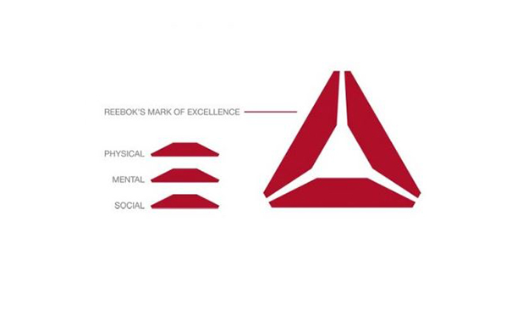
Positioning
Reebok
Strives to be Eco-friendly
Premium sports and lifestyle brand
Trend Setters
Economical
Performance Oriented

Slide 10
Survey Analysis
Sample size : 100
Gender: Males : 57 ; Females : 43
Willingness to pay : Pricy – 6% ; Moderate : 66%
Reasons to buy: Necessity – 63% ; Variety : 15% ; Desire : 10% ; Offers: 12 %
Brand Preferred : Nike – 40% ; Reebok – 18% ; Adidas – 17% ; Others – 26%
Brand affinity reasons : Comfort , Durability, Value for purchase, Economical.
(79% of the sample) People await promotional offers such as thanksgiving or off-season clearance sales
66% of the sample are interested in merchandized goods from their favorite brands
77% of the sample prefer internet over Print Media, Direct Mail or Radio, for promotions/advertisements.

Slide 11
SWOT Analysis
Strengths
-- Brand Equity and awareness
-- Perfect combination of technology and trend
-- Brand endorsements
-- Widespread business
Weakness
-- Easily affected by controversies
-- Adidas is its parent company
-- Not on par with merchandizing market
Opportunities
-- Target kids section
-- Tie ups with academic and schools, worldwide
-- Expand lifestyle section
-- Innovations in sport designs
Threats
-- Competition from international brands
-- Faking issues
-- Product Cannibalization

Slide 12
Proposed Marketing Strategy
Diversification is a good way to grow one’s business, while seeking new portfolio or opportunities outside the current business.
In Reebok’s case, any expansion strategy associate with existing market or existing product is unlikely to gain growth significantly, because of the competition in the industry.
Therefore, as per our research, diversification becomes the best solution.
 | Existing product | New product
Existing market | Market penetration | Product development
New market | Market development | Diversification

Slide 13
Product
Reebok releases products almost every year. Running shoes contribute to its best selling category.
Innovation and Trending is the key factor in footwear industry. Invest more in R&D and tie up with other small innovative competitor markets to encourage creativity
Reebok had seen a steady decline in its revenue 3 years ago. However, it has managed to revamp itself by forming a 40-person team to design products that weren’t just focused on comfort and function but also on provided high-tech in their shoes
Focus on innovation in Sole Technology.
Feature importance and customization based on different segments.

Slide 14
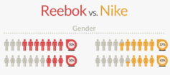
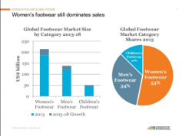
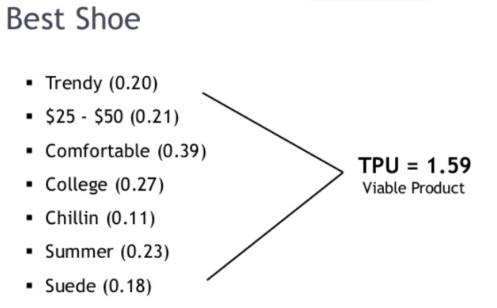
Product development
Women’s rising interest in health and fitness has lead the experts to predict that the Women's sport shoe sales market can double in size by 2020

Slide 15
Price
Reebok is known for its pricing in the market. It has got Competitive Market pricing. It maintains its reputation as middle priced brand when compared to Nike and Adidas
They maintain good frequency of promotional sales throughout the year to increase customer base and maintain customer satisfaction.
Skimming Policy and destroyer policy
They utilize a 100% outsourcing strategy and manufacture their products throughout Asia leading to a low initial investment.

Slide 16
Placement/Distribution
In the US, 60 percent of Reebok’s sales come through wholesale channels, while 40 percent are direct-to-consumer (primarily through Reebok-operated stores)
Reebok shoes are sold by other multi brand stores and exclusive Reebok stores worldwide
Reebok makes shoes in at least a dozen factories in several countries but most of them are in Asia
Reebok should focus on more visibility in the outlets to capture the market attention since 63% of the purchases made in US are through outlets.

Slide 17
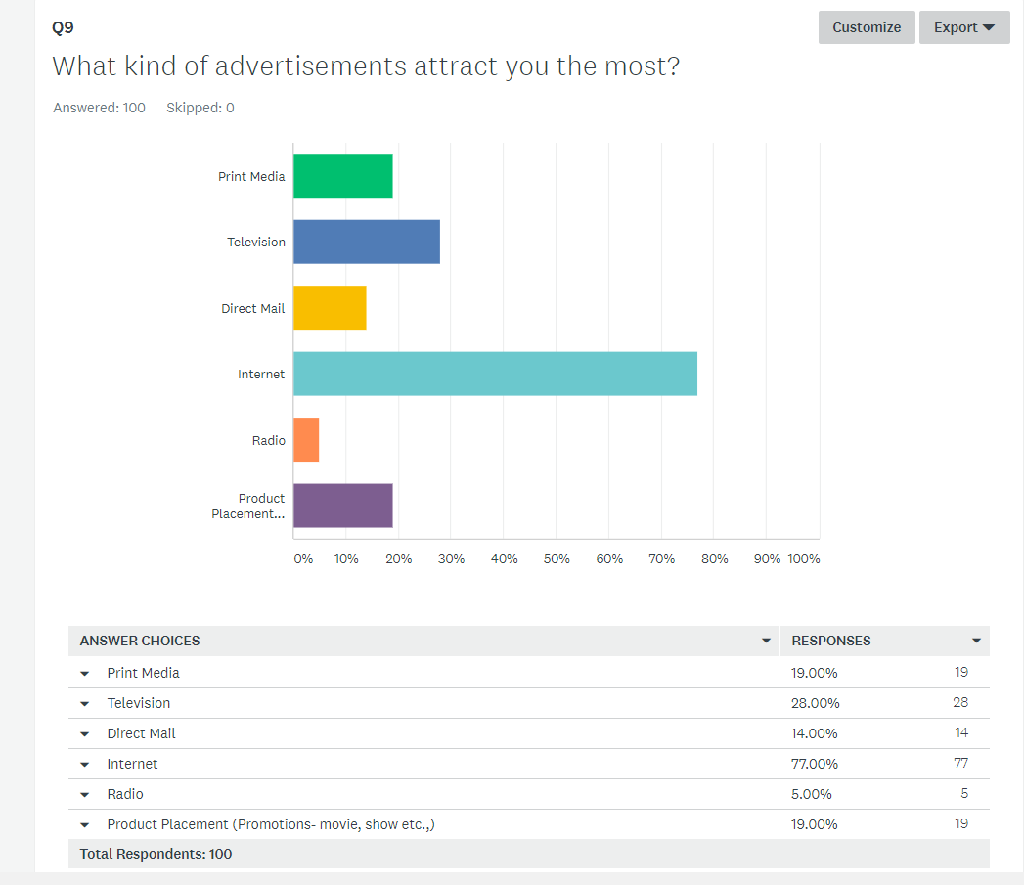
Promotion
As a sports brand, Reebok should expand its social media activities to create a buzz about its new set of products
Reebok uses Commercials, celebrities or billboards as ways to make its target customer aware about its offers.
Reebok should focus on good branding , build good marketing strategies through advertising, tag line development and promotions.

Slide 18
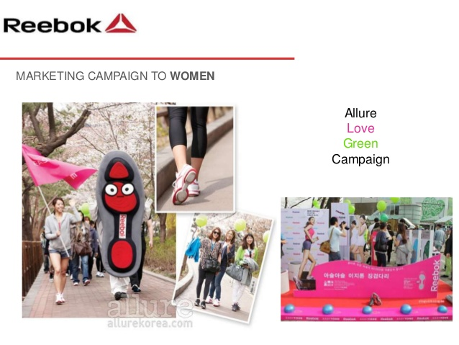
Future Aspects
Focusing on Women section and having more variations in this range of products
Expand market share with lower priced shoes in $25 to $50 range.
Create hype by reissuing classic editions
Build your brand with influencers – make it authentic
Have promotional coupons, which make customers come back and redeem the same. This improves brand awareness and customer attraction.
Let the consumers have what they want, give them the option to customize their shoes
Notes:
Read more at https://www.campaignlive.co.uk/article/six-lessons-nike-adidas-create-hype-millennial-hysteria/1334454#0iWJrkLMFd75g2wV.99

Slide 19
Questions?

